Slide 1
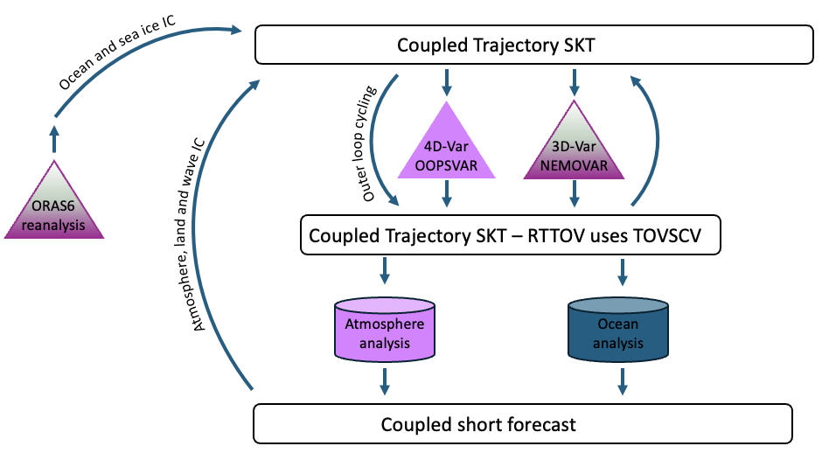
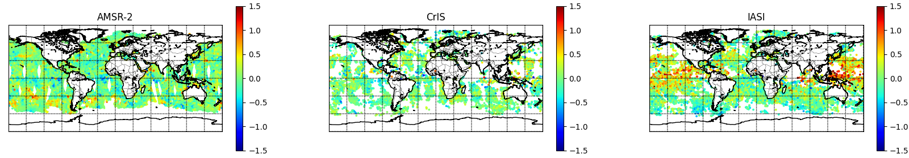
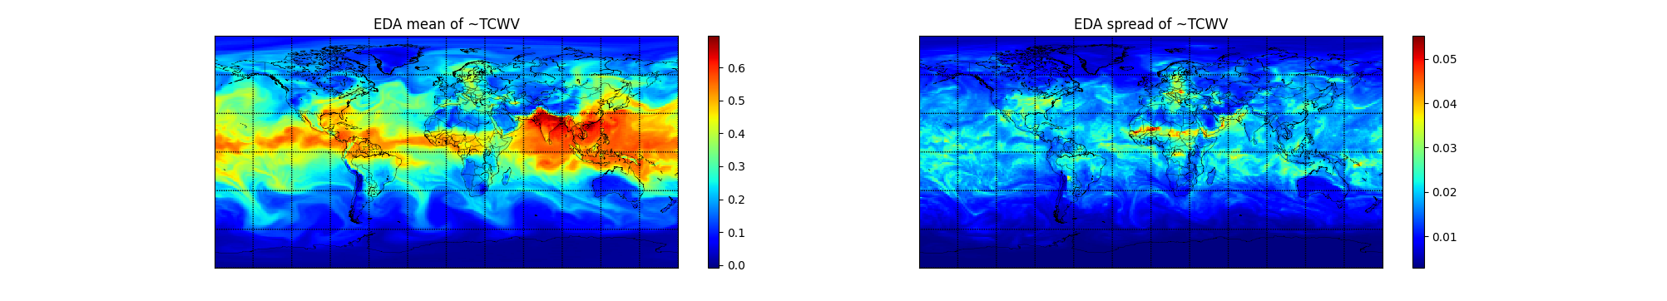
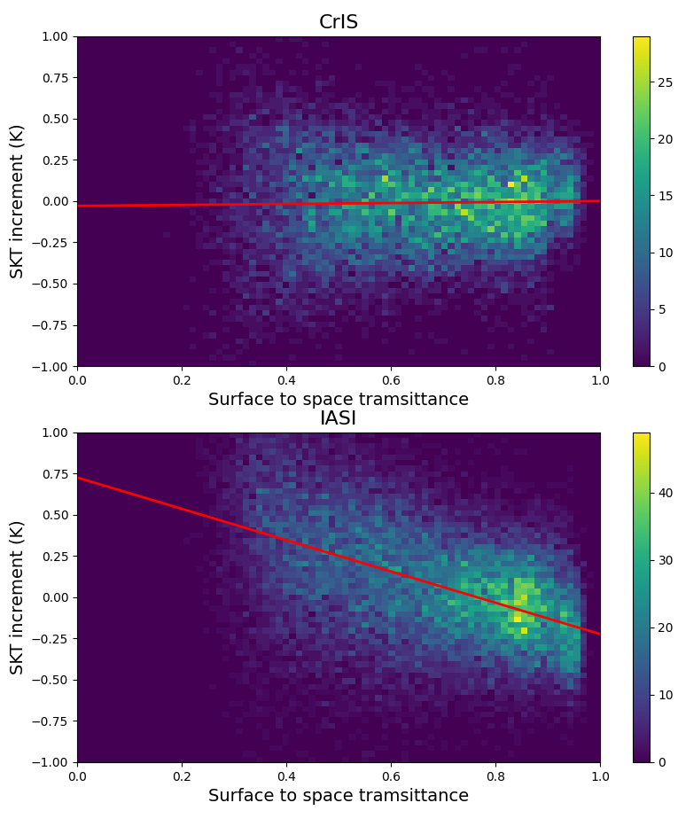
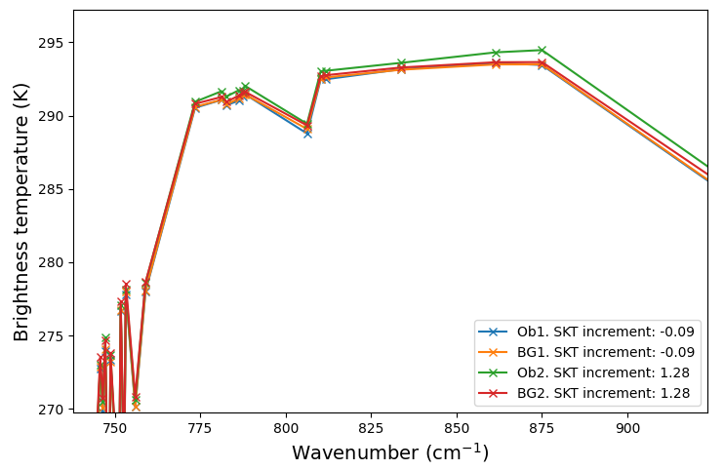

Challenges in the use of hyperspectral infrared radiance
observations in coupled global ocean/atmosphere assimilation systems
Chris Burrows, Tony McNally, Tracy Scanlon, Angela Benedetti, Phil Browne and Patricia De Rosnay
Research Department, ECMWF, Reading, United Kingdom.
Introduction
At ECMWF, a key area of development is improving the coupling of various elements of the earth system within the data assimilation framework. The topic covered here is that of the atmosphere-ocean interface, where infrared (IR) observations can be sensitive to both the atmospheric temperature/humidity and the sea surface temperature. Currently, the atmospheric analysis uses OSTIA as the first guess of the ocean foundation temperature from which the skin temperature (SKT) is estimated, and then, for each IR sounding, which is sensitive to the skin temperature (SKT), a SKT sink variable is adjusted in order to simulate more accurate radiances which assist in constraining the atmospheric analysis.
A first step in using IR data to provide an optimal estimate of the sea surface temperature (SKT) has been to pass the analysed SKT sink variables into the ocean analysis, with the aim of generating an improved coupled analysis.
Outer loop coupling – “RadSST”
The SKT values at the observation locations from the atmospheric analysis are passed to NEMOVAR as pseudo-observations after the first outer loop and onwards. This assumes complete trust in the cool skin parameterisation.
When the atmospheric and ocean analyses have been produced, they are combined into a coupled analysis.
1
2
Skin temperature increments from IR and other instruments
The skin temperature sink variable is computed for all satellite radiance observations, with one SKT analysed for each sounding location. Plotting maps of these increments for a single day (July 1st 2022) we see that IASI produces larger positive SKT increments compared to the other instruments, and this is representative of all dates investigated.
3
Investigation into IASI being the outlier
Model humidity
It can be seen that the model humidity is very high in the regions where IASI produces large positive SKT increments, and the spread in the ensemble of data assimilations (EDA), i.e. the background error, is relatively small, which is likely to allow the SKT to pull strongly to the observations.
4
5
The fact that IASI behaves so differently could be due to various factors. The observations could be somehow inconsistent with other observations, perhaps due to the high spectral resolution; the forward modelling could be sub-optimal, in terms of the atmosphere or surface components including emissivity; the cloud/aerosol detection may need refining; the 4D-Var minimisation may give increments that are too large in certain conditions (e.g. close to saturation); the observation error covariances may be too small.
The clearest clue as to the mechanism is the correlation between the SKT increments and the clear-sky model-based surface-to-space transmittance (τ_{sfc}) for window channels, and plotted here is a 2D histogram of the skin temperature increments binned by τ_{sfc} for CrIS (867.5cm⁻¹) and IASI (875cm⁻¹).
Individual spectra
v
Only observations flagged as cloud-free are included in these statistics, though there may be model cloud at these locations.
This suggests that the large positive increments are due to scenes where the transmittance is low, and likely due to the water vapour continuum affecting the window channels. For such window channels, the same bias correction is applied for transparent and opaque scenes.
6
Two nearby observations have been compared spectrally, having SKT increments of 1.28K and -0.09K. The observed spectrum causing the 1.28K SKT increment (green line) has larger window channel brightness temperatures than both the model and other nearby observations, so the “warm” observation is potentially not being well-simulated by the model.
Outlook
7
Some hypotheses for the cause of the large positive SKT increments from IASI have been investigated and dismissed, but the exact mechanism is still to be determined. Rejecting observations with low values of τ_{sfc} is an effective pragmatic solution which can be used until this is fully understood.
Thanks to Marco Matricardi and Robin Hogan for useful discussions.

