Slide 1
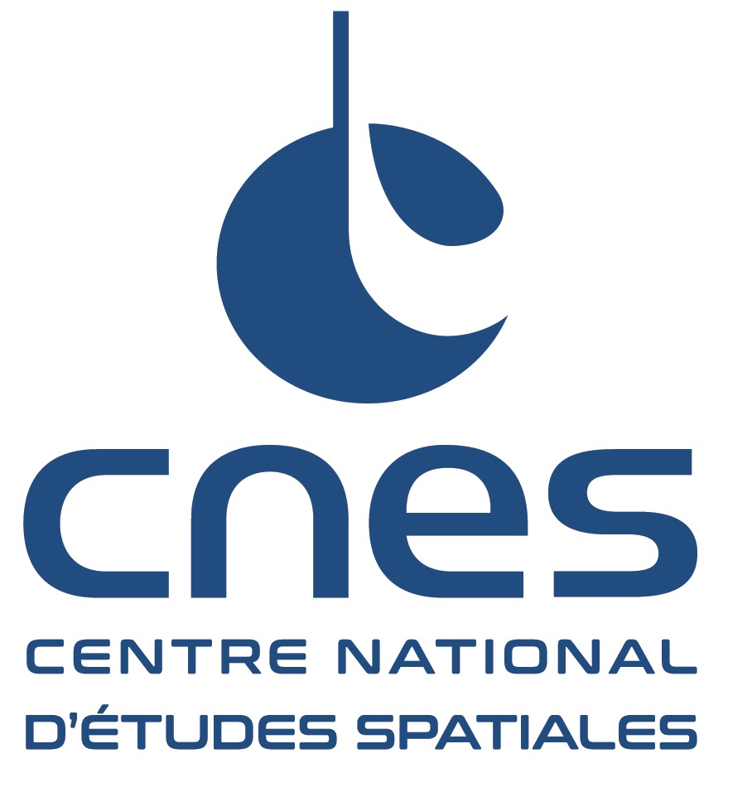
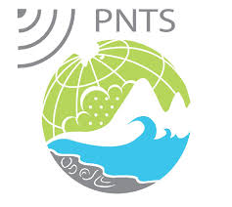
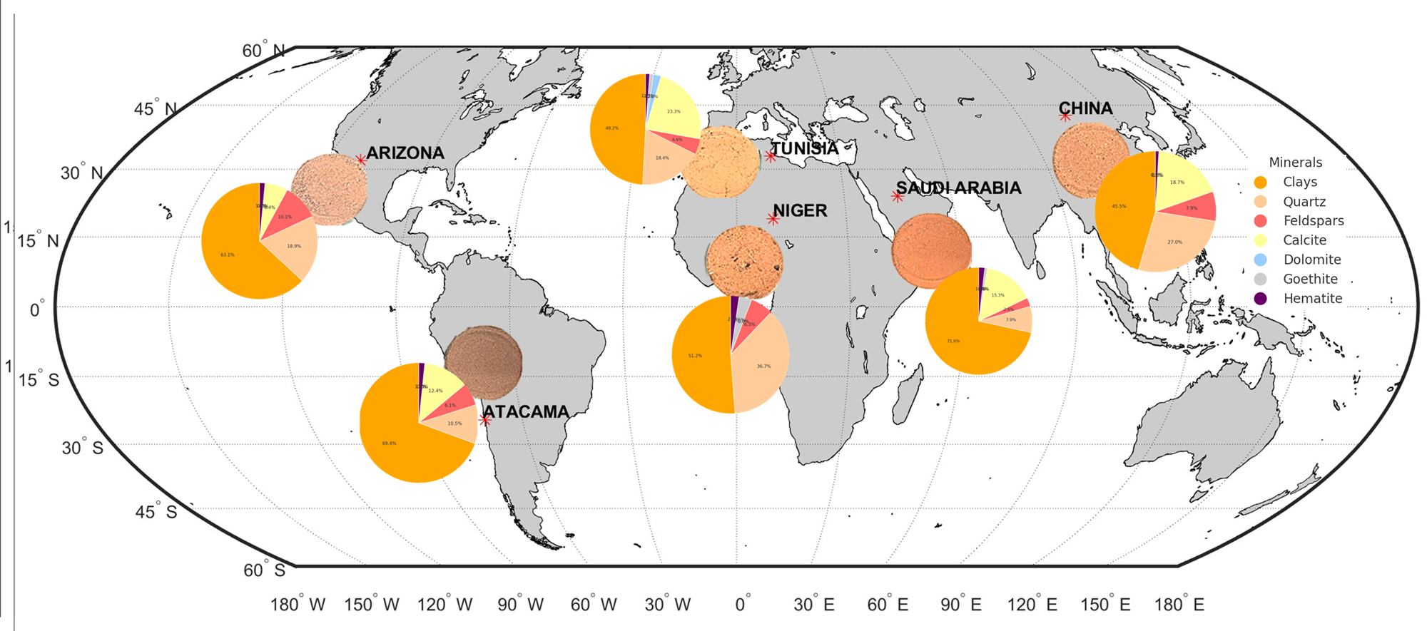
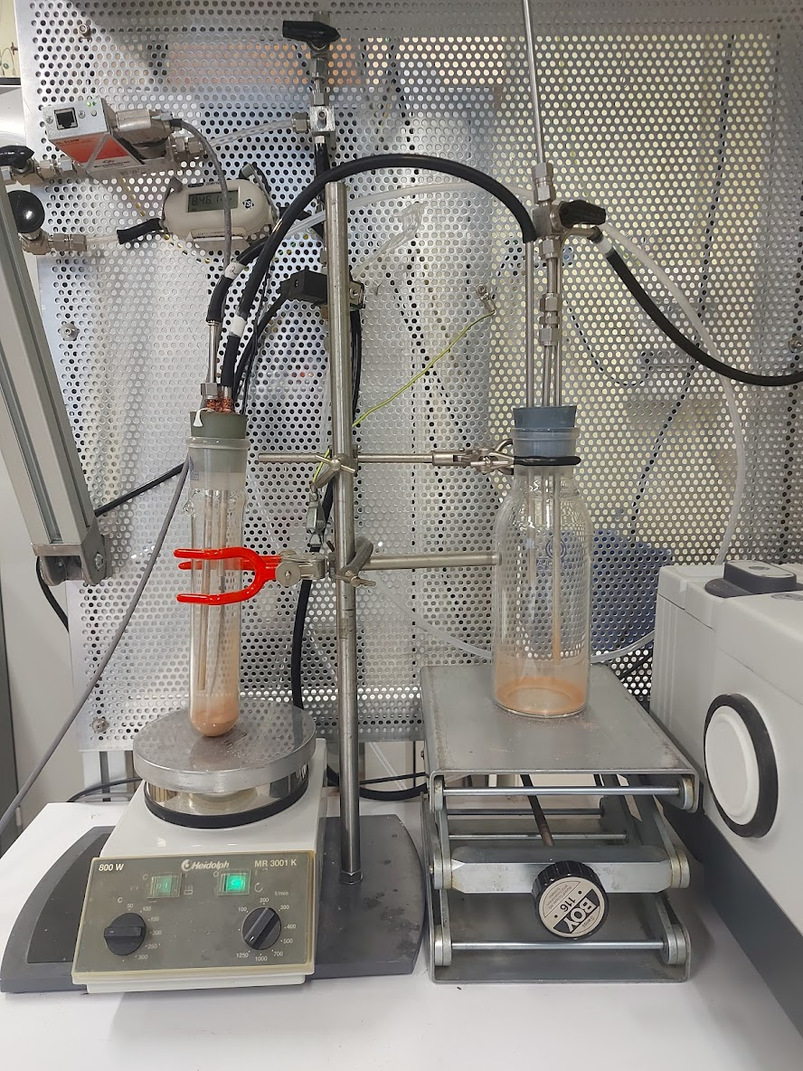
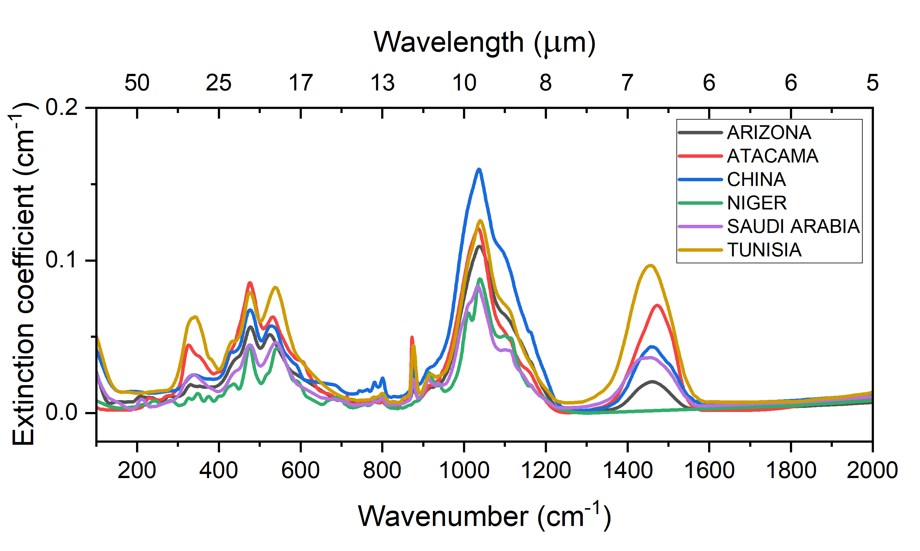
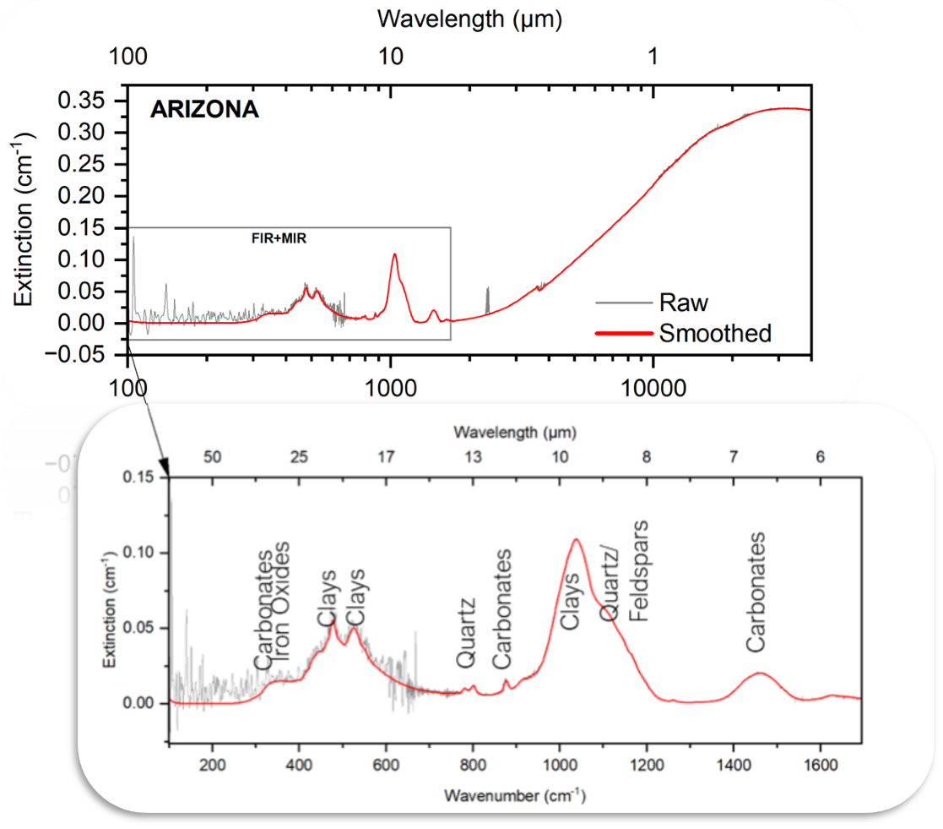
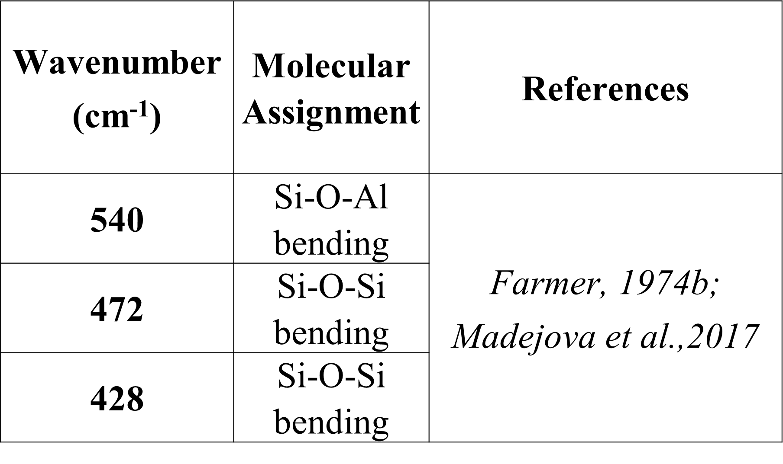
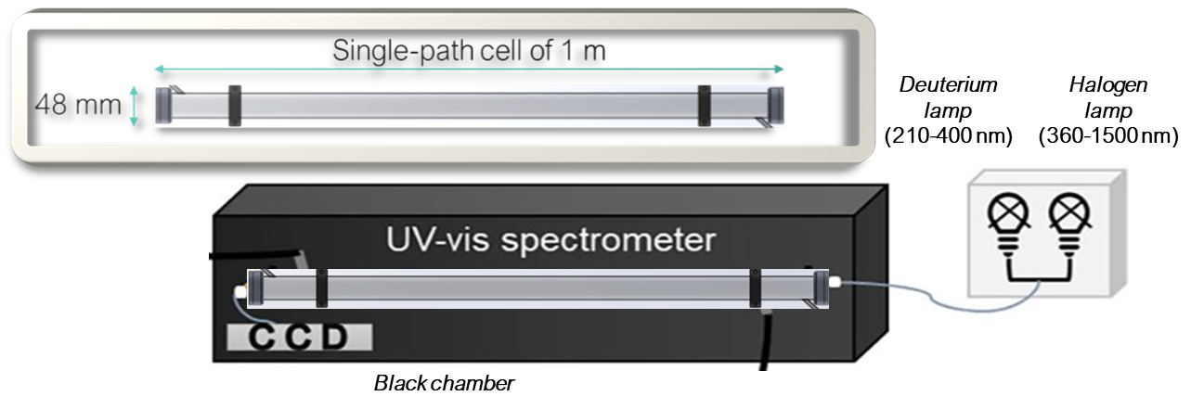
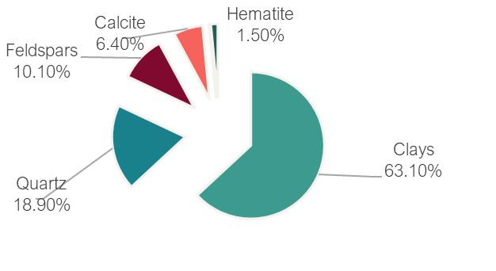
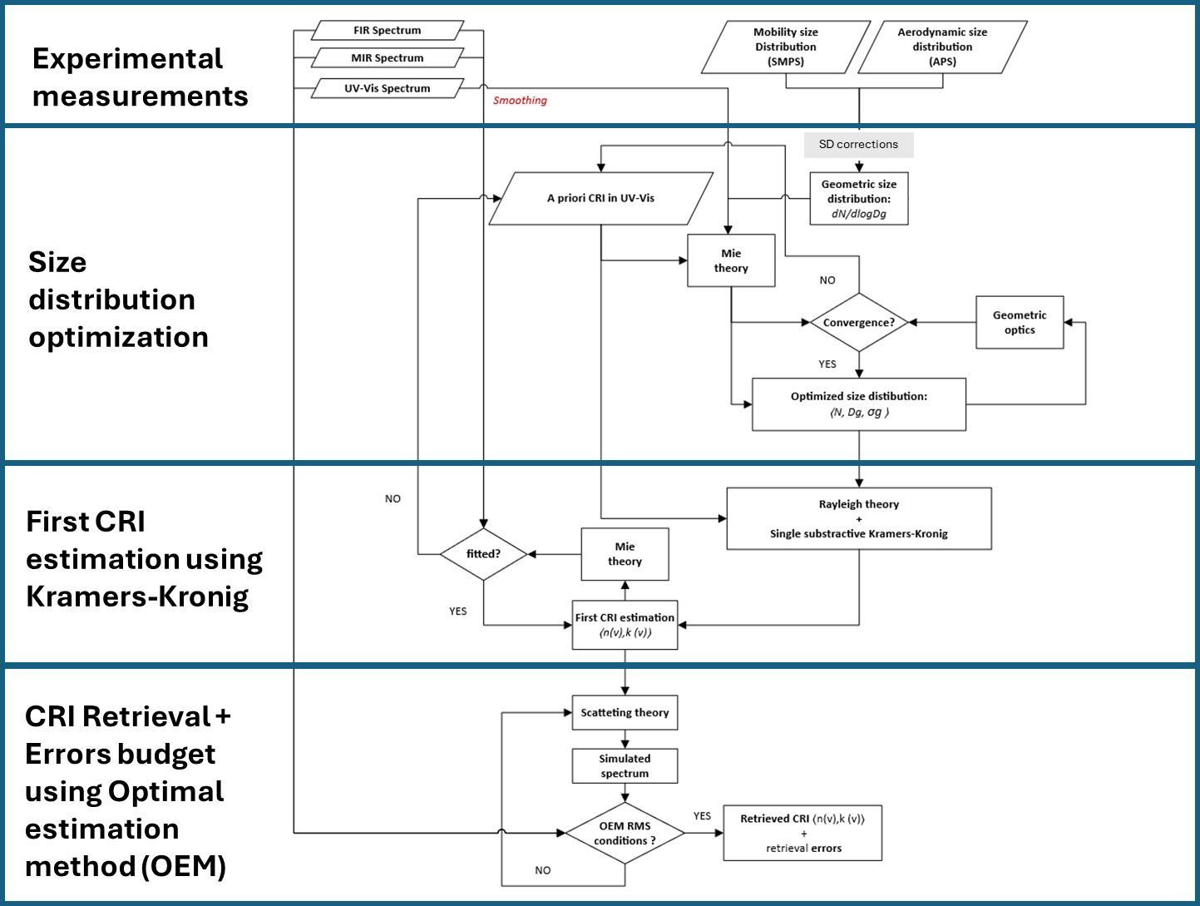
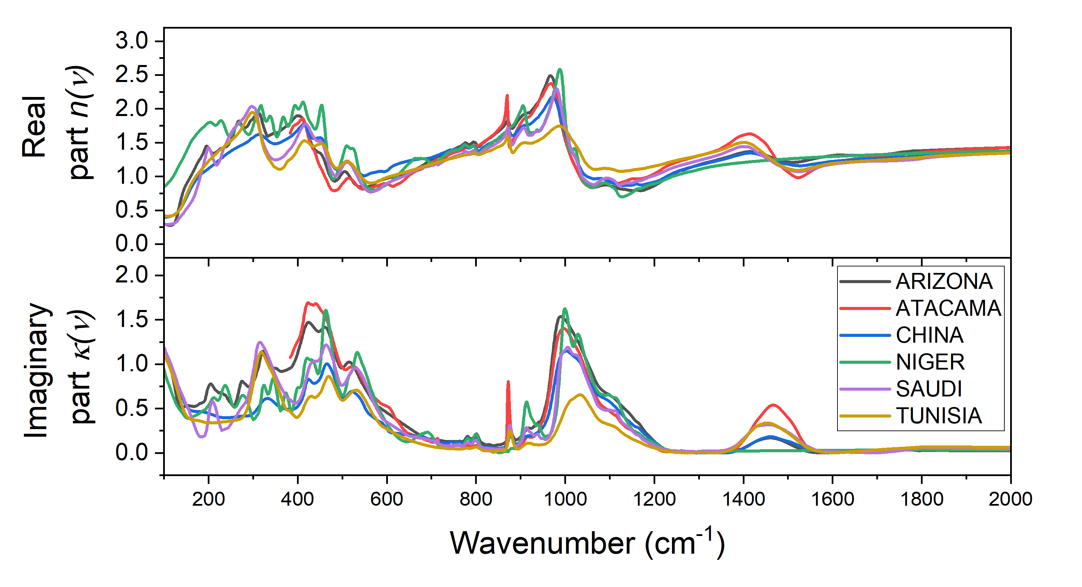
Global Scale Mapping of Mineral Dust in situ Optical Properties in the MIR+FIR spectral domain (100 to 2000 cm⁻¹): Spectroscopic studies towards the exploitation of IASI−NG and FORUM forthcoming missions
P. Alalam¹ ², C. Di Biagio³, P. Sellitto¹ ⁴, H. Herbin⁵, D. Petitprez⁶, V. Bizet ⁶, S. Gosselin⁶, E. Bru³, A. Orta³, J. Cuesta¹, P. Formenti³, P. Roy⁷, J.–B. Brubach⁷, L. C.-Labonnote⁵, Q. Libois⁸
¹ Université Paris Est Creteil and Université Paris Cité, CNRS, LISA, F-94010 Créteil, France ² CNES (Centre National d'Études Spatiales), 75001, Paris, France ³ Université Paris Cité and Université Paris Est Creteil, CNRS, LISA, F-75013 Paris, France ⁴ Istituto Nazionale di Geofisica e Vulcanologia, Osservatorio Etneo, Catania, Italy
⁵ Université de Lille, CNRS, UMR 8518, LOA, F-59000 Lille, France ⁶ Université de Lille, CNRS, UMR 8522, PC2A, F-59000 Lille, France ⁷ SOLEIL Synchrotron, L’Orme des Merisiers, 91190 Saint-Aubin, France ⁸ CNRM, Université de Toulouse, Météo-France, CNRS, CNRM, F-31057 Toulouse, France
Introduction
Mineral dust aerosols significantly influence the Earth's radiative budget by interacting with radiation through absorption and scattering. However, accurately estimating their direct radiative effect (DRE) remains challenging due to limited knowledge of their physical and chemical properties and variability. The complex refractive index (CRI) is crucial for retrieving aerosol parameters i.e., size distribution, concentration and chemical composition, using satellite instruments. While mid-infrared (MIR, 650 to 4000 ${cm}^{−1}$) studies have advanced aerosol characterization, far-infrared (FIR, 100 to 650 ${cm}^{−1}$) interactions remain largely unexplored. Recent studies show FIR signatures are sensitive to dust spectral features, highlighting their potential for enhanced dust characterization. This work addresses the gap in FIR data by developing a global map of mineral dust optical properties (100 to 2000 ${cm}^{−1}$) to support IASI-NG and FORUM missions. By leveraging state-of-the-art and realistic aerosol generation methods, this study provides high-resolution optical properties, advancing satellite synergy and improving the understanding of dust-radiation interactions.
Methodology and Results
II- EXPERIMENTAL MEASUREMENTS
I- SOIL SAMPLES SELECTION
The setup is purged with N₂ to reduce strong IR absorption by H₂O and CO₂.
Measurements under dry ambient conditions (T= 274K; P = 1 atm).
II.A- Generation system
Six samples were selected to represent different geographic regions and cover the diversity of mineral dust composition on a global scale.
Pulse rate: Controlled by a software creating wind fronts.
2
Buffer volume:
Homogenization of the particles number concentration.
1
3
Samples and minerology from Di Biagio et al., 2017
Chehab et al., 2024
Agitation rate: Controlled by the magnetic sterling system and acts on the erodibility of the soil.
II.B – Extinction measurements
Spectrometers
Data treatment
Results
FTIR Michelson Interferometer
The multi-pass cell of 10 m optical path with an aerosol shower-spray
Smoothing spectra to reduce gas absorption signals while preserving aerosol extinction shape and intensity.
Aerosols inlet
shower-spray
Molecular assignments database
Mineralogy
The spectral features reveal diverse mineral compositions, including the first-time detection of iron oxides peaks in FIR.
The contrast in the optical properties reflects the contrast in the mineralogical composition.
II.C – Size distribution measurements
III- OPTICAL PROPERTIES RETRIEVAL
Study flowchart
Preliminary results
Complex refractive indices of dust were obtained in the infrared range filling the gap for the first time in the far-infrared spectrum.
Measurements compared with literature in-situ data (Formenti & Di Biagio., 2024):
Best coherence with LRT size distribution.
Conclusions and Perspectives
References
New measurements of mineral dust's optical properties fills the gap in the far-infrared spectrum.
Performing CRI retrievals and calculate the error budget.
Future FIR measurements at SOLEIL synchrotron to test the reproducibility and the reliability of the retrieved CRIs. Moreover, a better signal to noise ratio is expected between 100 and 300 ${cm}^{−1}$.
Implement new datasets in radiative transfer models to evaluate the contribution of FIR for improving dust characterization in support IASI-NG and FORUM satellite missions.
Chehab et al., 2024. Aerosol Sci. Technol. https://doi.org/10.1080/02786826.2024.2318371
Di Biagio et al., 2017. Atmos. Chem. Phys.
https://doi.org/10.5194/acp-17-1901-2017
Formenti & Di Biagio., 2024. Preprint
. https://doi.org/10.5194/essd-2023-481
Acknowledgement
This work has been supported by the Centre National d’Etudes Spatiales (CNES) via the TOSCA/FORUM grant and by the PNTS programme of CNRS-INSU via the IR-DUST grant. P. Alalam is supported by CNES by a post doctoral grant.

