Slide 1


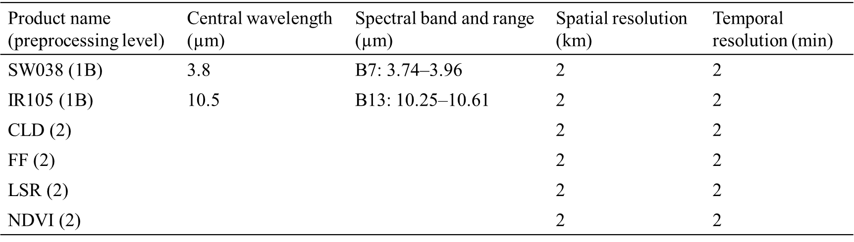
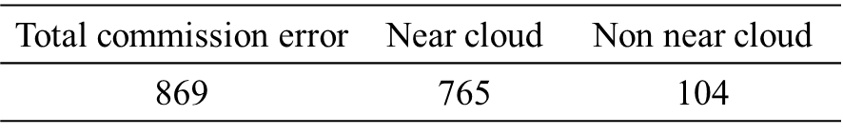
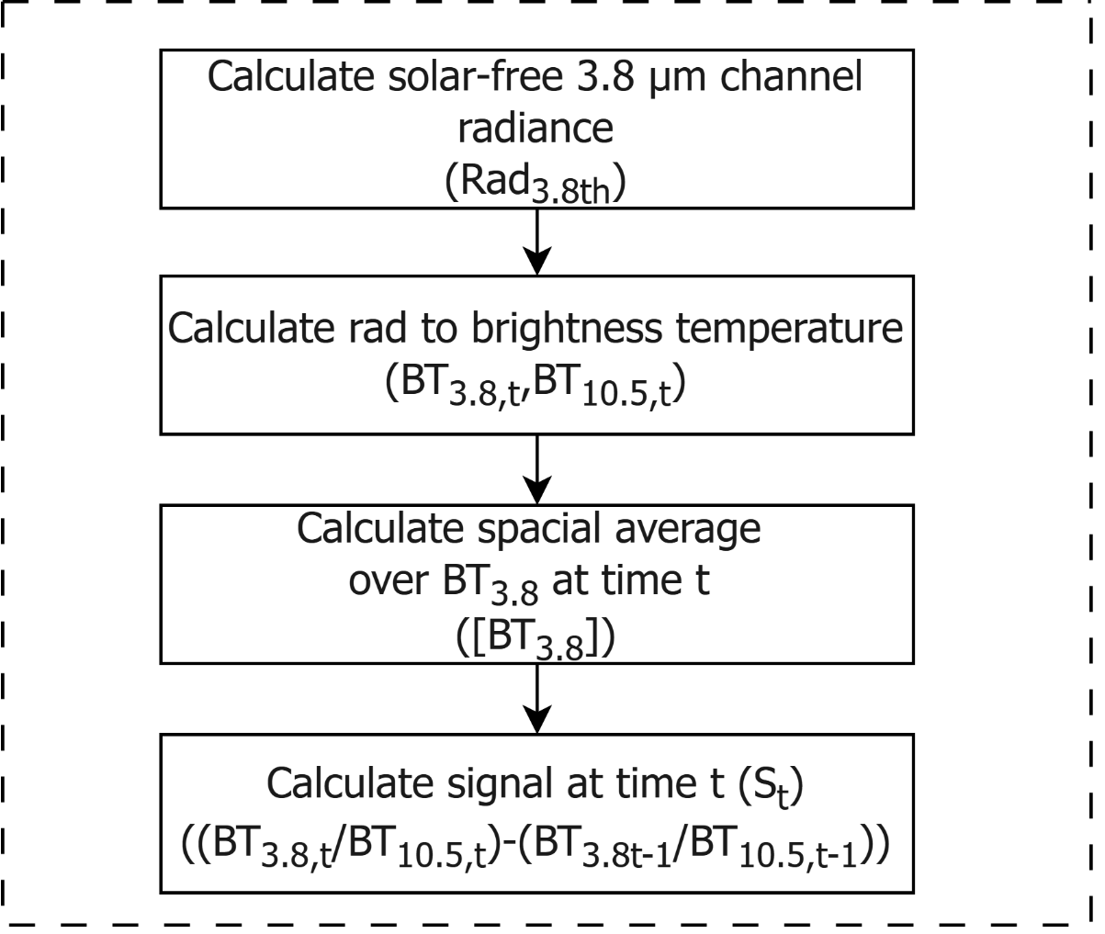
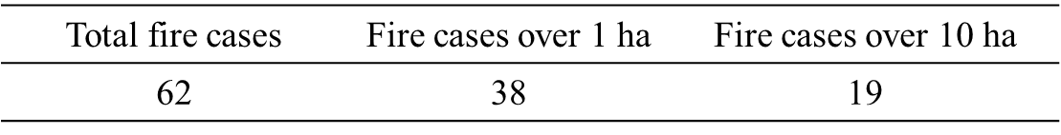

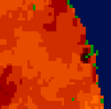
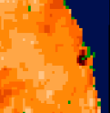
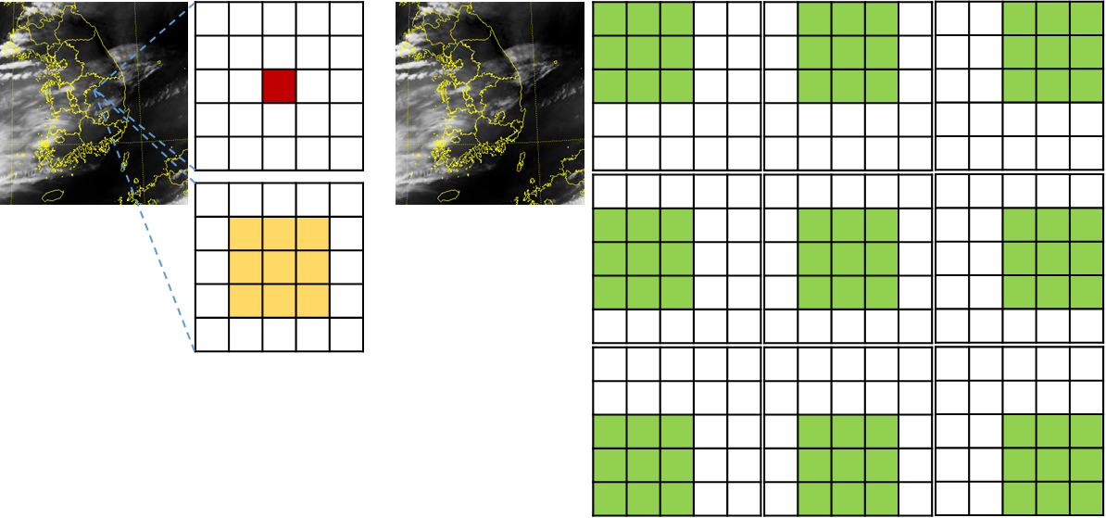
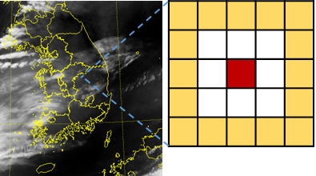
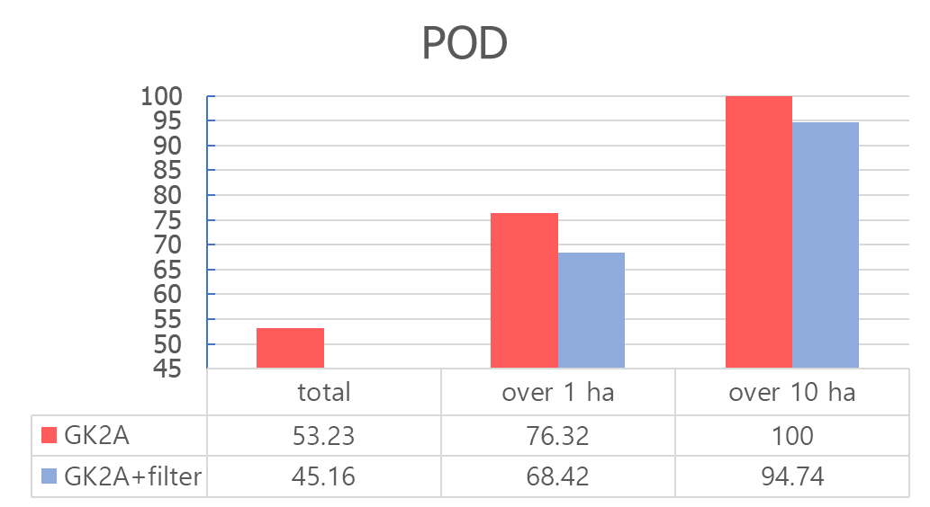
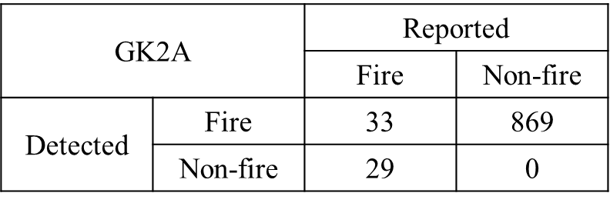
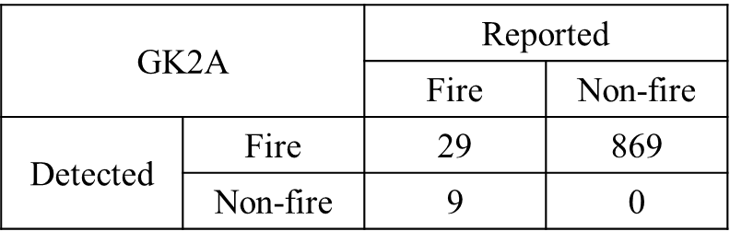
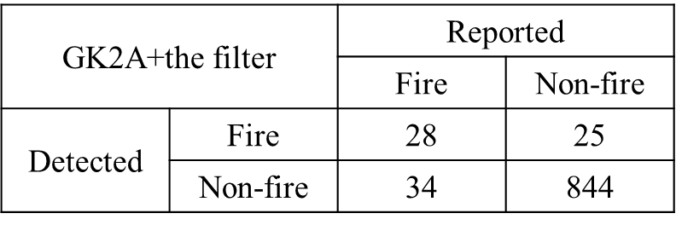
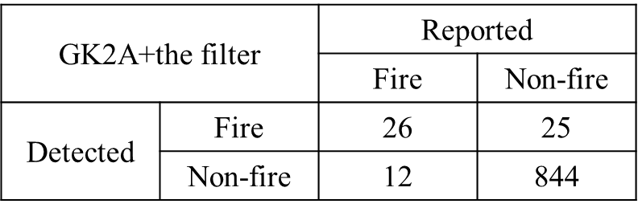
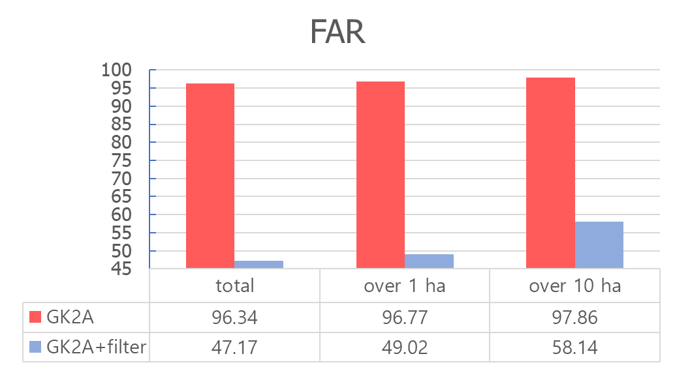
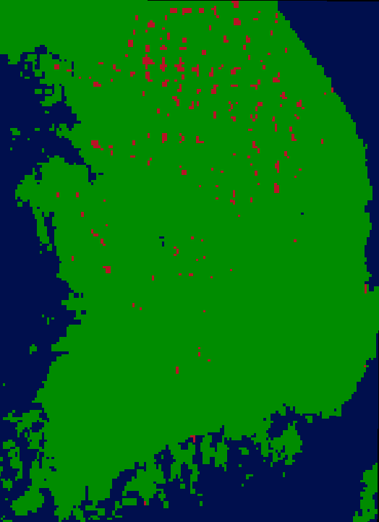

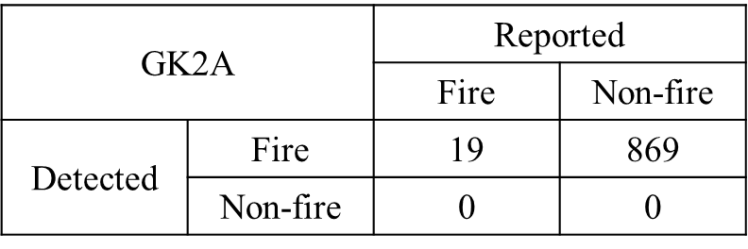
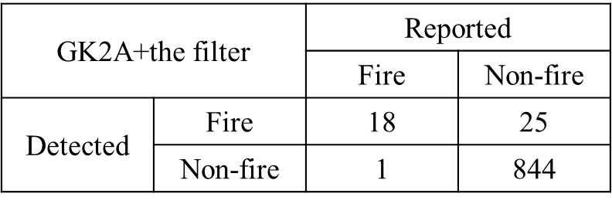
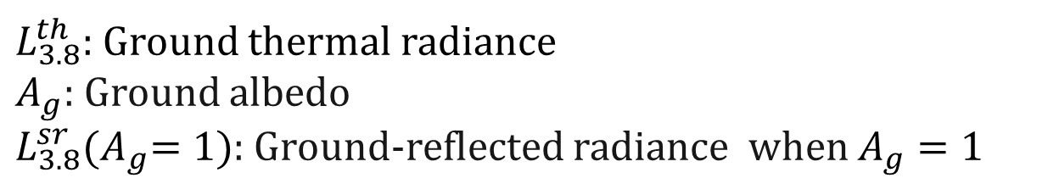
S1- 04
Development of the False Alarm Filtering Method for GEO-KOMPSAT-2A Forest Fire Detection Product
Seoyoung Chae, Yong-Sang Choi
Ewha Womans University, Republic of Korea
Email: cotjdud2@naver.com
#FFC107
Introduction
Data
Wildfires can influence people’s lives.
Satellite is the best tool of real-time observation of disasters.
According to previous studies, satellite wildfire detection often exhibits significant commission errors (YING et al., 2019; GIGLIO et al., 2006).
Actual data shows a number of wildfire commission errors occurring around clouds.
GK2A AMI Data
Using Observation data from Advanced Meteorological Imager(AMI) loaded on GEO-KOMPSAT-2A(GK2A).
Presence of clouds in case of error occurrence
L_3.8^sr=A_g L_3.8^sr 〖(A〗_g=1)
Method
Calculation
PART 1.
- Separate solar reflectance radiance from the 3.8 µm channel to use only thermal radiance with (Choi et al., 2007).
Wildfire cases
PART 1.
Data on the date, location, and damaged area of 62 wildfires that occurred in 2022 (Korean Forest Service, 2023).
The algorithm was preliminarily constructed based on 19 wildfire cases exceeding 10 ha damaged area.
PART 2.
$L_{3.8}^{th}:$ Ground thermal radiance
$A_{g}$: Ground albedo
$L_{3.8}^{sr}{(A}_{g}=1)$: Ground-reflected radiance when $A_{g}=1$
Time correlation test
- Make a correlation map using test field and compare field.
- If the central value of the correlation map meets the following criteria, it confirms a wildfire.
(a) Before calculation
(b) After calculation
- Temperature in surrounding wildfire area are decreased after the calculation.
PART 2.
- Calculate a signal incorporating temperature differences over time.
- Distinguish between a cloud and a wildfire based on whether the pixel is moving.
Pop-up fire test
Test pixel
Test field
Compare field
- Confirm that there are no clouds in the test field.
Result
- High FAR appears to have a number of causes.
When the forest fire is much smaller than the spatial resolution of GK2A (2km x 2km).
When a wildfire occurs, it brings smoke which interferes with the signal like cirrus clouds.
(a) Total fire cases validation result
(b) 1 ha over fire cases validation result
(d)
(e)
(c) 10 ha over fire cases validation result
- The filtered product resulted in 844 (about 97% of total commission errors) fewer commission errors than the GK2A product.
- Commission error includes habitual detection areas due to industrial clusters.
example of 3 hours stacked data (d) GK2A wildfire product and (e) filtered GK2A wildfire product
Conclusion
- This study developed a filtering method that reduces the commission error of the GK2A wildfire detection.
- The filtering method used the difference between the activities of clouds and wildfires.
- As a result, although it has insufficient FAR to be operated, commission errors could be reduced from 869 to 25 it does not significantly drop POD.
References
CHOI, Y., HO, C., AHN, M. and KIM, Y., 2007. An exploratory study of cloud remote sensing capabilities of the Communication, Ocean and Meteorological Satellite (COMS) imagery. International Journal of Remote Sensing, 28(21), pp. 4715–4732.
DOZIER, J., 1981. A method for satellite identification of surface temperature fields of subpixel resolution. Remote Sensing of Environment, 11, pp. 221–229.
GIGLIO, L., CSISZAR, I. and JUSTICE, C.O., 2006. Global distribution and seasonality of active fires as observed with the Terra and Aqua Moderate Resolution Imaging Spectroradiometer (MODIS) sensors. Journal of geophysical research: Biogeosciences, 111(G2).
Korea Forest Service, 2022, 2022 Annual Report on Wildfire Statistics, https://www.index.go.kr/unity/potal/main/EachDtlPageDetail.do?idx_cd=1309, Accessed on Nov. 18, 2024
National Meteorological Satellite Center, GEO-KOMPSAT-2A Algorithm Theoretical Basis Document, https://nmsc.kma.go.kr/homepage/html/base/cmm/selectPage.do?page=static.edu.atbdGk2a, Accessed on Nov. 28,2024
YING, L., SHEN, Z., YANG, M. and PIAO, S., 2019. Wildfire detection probability of MODIS fire products under the constraint of environmental factors: A study based on confirmed ground wildfire records. Remote Sensing, 11(24), pp. 3031.

